Slide 1

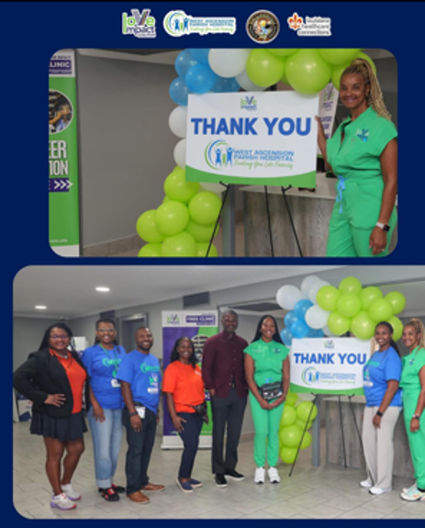

West Ascension Parish Hospital
Love Impact
Coalition
Free Clinic
Summary Report
Ms. Donna Lewis
Dr. Nicole Thomas
westaph.org
225-473-7931
301 Memorial Drive, Donaldsonville, LA 70346

Slide 2


Executive Summary
Love Impact Coalition successfully conducted a comprehensive free health clinic providing dental, vision, and medical services to the community.
The event served 497 registered patients with the support of 212 volunteers, delivering essential healthcare services to those in need.
The combined value of healthcare services and volunteer labor exceeded $400,000, demonstrating the significant community impact of this single-day event.
West Ascension Parish Hospital

Slide 3
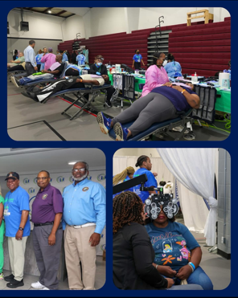
Free Clinic Event: Patient Services Overview
The clinic registered a total of 497 patients who received access to dental, vision, and medical care. Vision services were particularly robust, with significant patient engagement across multiple service categories.
West Ascension Parish Hospital

Slide 4
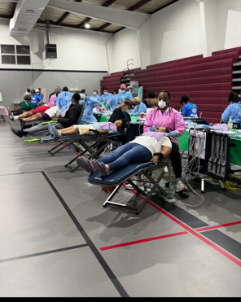
Vision Services Delivered
147 patients received comprehensive eye examinations
161 patients received basic prescription eyeglasses
29 patients received progressive lenses
Financial Impact
Eye exams value: $29,400
Basic prescription eyeglasses value: $40,250
Progressive prescription eyeglasses value: $10,875
Total vision services value delivered: $80,525
These vision services addressed a critical healthcare need, providing both diagnostic care and corrective eyewear to improve patients' quality of life and daily functioning. The total value of vision care delivered exceeded $80,000, representing substantial healthcare access for individuals who might otherwise go without essential vision correction.
West Ascension Parish Hospital

Slide 5
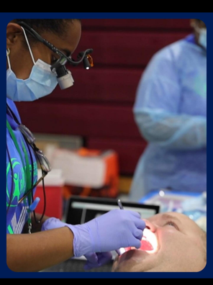
Dental Services Delivered
Preventive/Hygiene Services
Total hygiene patients: 149
Patients receiving prophylaxis (cleaning): 128
Patients receiving fluoride treatment: 122
Hygiene services not provided: 21
Total patients examined/received X-rays: 146
Patients treated: 114
Patients referred for additional care: 32
Fillings performed: 27
Extractions performed: 150
Overall Dental Impact
Total patients seen (treatment + hygiene): 295
Total patients treated: 242
Total dental care value delivered: $84,467
Total hygiene care value delivered: $21,000
Total overall dental care value delivered: $105,46
The dental services addressed critical oral health needs in the community, with 150 extractions indicating significant untreated dental disease among patients. The combination of restorative treatment and preventive care demonstrates a comprehensive approach to improving oral health outcomes. The total value of care delivered exceeded $105,000, representing substantial healthcare access for individuals who might otherwise go without dental treatment.
West Ascension Parish Hospital

Slide 6
Medical Services Delivered
Total patients receiving care through clinic’s medical department: 64
The medical department addressed a range of acute and chronic health conditions:
1. Uncontrolled hypertension: 22 patients (34%)
2. Physical examination: 11 patients (17%)
3. Elevated blood glucose: 11 patients (17%)
4. Cough: 3 patients (5%)
5. Ear pain: 2 patients (3%
Clinical Outcomes and Follow-Up Care
Prescriptions Written: 18
Referrals Made: 25
The prevalence of uncontrolled hypertension and elevated blood glucose among patients highlights significant chronic disease management needs within the community. These conditions, if left untreated, can lead to serious health complications including heart disease, stroke, and diabetes.
West Ascension Parish Hospital

Slide 7
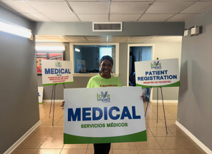
Medical Services Financial Impact
Based on national average healthcare costs:
Primary care visits (64 patients @ $200 average): $12,800
Prescriptions written (18 @ $75 average): $1,350
Specialist referral value (25 @ $300 average future visit cost): $7,500
Total medical services value delivered: $21,650
Without insurance, primary care visits typically range from $150 to $300, making these services critically important for uninsured and underinsured patients. The medical department's work connecting patients to ongoing care through prescriptions and referrals represents an investment in long-term health outcomes beyond the immediate clinic day.
West Ascension Parish Hospital

Slide 8
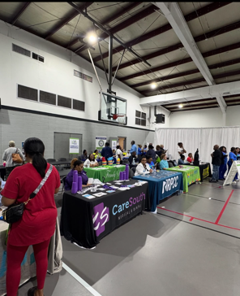
Patient Demographics
Gender Distribution:
Female: 348 patients (70%)
Male: 149 patients (30%)
Racial/Ethnic Breakdown:
Black: 411 patients (83%)
White: 40 patients (8%)
Other: 45 patients (9%)
American Indian: 1 patient (<1%)
The demographic data reveals that the clinic primarily served Black community members, highlighting Love Impact Coalition's reach within this population and the organization's role in addressing healthcare disparities.
Age Distribution:
The majority of patients served were between 50 and 70 years old, with a peak around 60 years of age. This age group typically faces increased healthcare needs, particularly for vision and chronic disease management. The clinic also served notable numbers of patients in their 20s, 30s, and 40s, demonstrating broad community appeal across adult age ranges. Fewer patients were represented in the youngest and oldest age groups.
West Ascension Parish Hospital

Slide 9
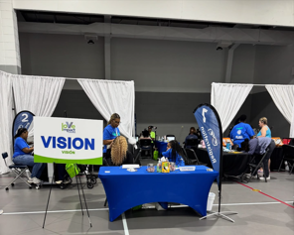
Patient Demographics
Geographic Distribution by Zip Code
The clinic drew patients from 10 zip codes across the region, with the following distribution:
70346: 231 patients (46%)
70737: 37 patients (7%)
70341: 26 patients (5%)
70086: 20 patients (4%)
70390: 18 patients (4%)
70090: 16 patients (3%)
70301: 14 patients (3%)
70769: 14 patients (3%)
70068: 8 patients (2%)
70726: 6 patients (1%)
The geographic data shows that nearly half of all patients came from the 70346 zip code area, indicating either proximity to the clinic location or a concentrated area of need. The clinic successfully attracted patients from a diverse geographic range, with representation from ten additional zip codes across the region.
West Ascension Parish Hospital

Slide 10
Volunteer Participation & Economic Impact
The clinic's success was made possible through strong volunteer engagement and organization, representing a significant investment of community time and professional expertise. The event required extensive planning and coordination, with department directors contributing substantial hours in pre-clinic development in addition to their work on clinic day.
Volunteer Registration & Attendance:
Registered volunteers: 236
Volunteers who attended: 212
Attendance rate: 90%
Volunteer Categories:
Clinical volunteers: 70 (33%)
General volunteers: 101 (48%)
Department directors: 14 (7%)
No-shows: 24 (10%)
The high volunteer attendance rate of 90% demonstrates strong commitment from the community and effective volunteer coordination. The diverse volunteer structure, including specialized clinical staff, leadership through department directors, and general support volunteers, enabled comprehensive service delivery across all clinic operations.
West Ascension Parish Hospital

Slide 11
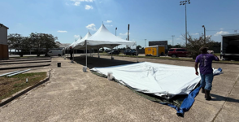
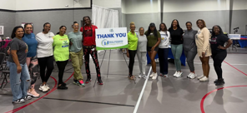
Volunteer Hours & Labor Value
Total Volunteer Hours Contributed: 2,376 hours
Department Directors (14 directors):
Pre-clinic planning and development: 40-60 hours per director (using 50-hour average)
Additional pre-clinic work: 8 hours per director
Clinic day work: 14 hours per director
Total per director: 72 hours
Total for all directors: 1,008 hours
Clinical Volunteers (70):
Clinic day work: 8 hours average
Total: 560 hours
General Volunteers (101):
Clinic day work: 8 hours average
Total: 808 hours
West Ascension Parish Hospital

Slide 12
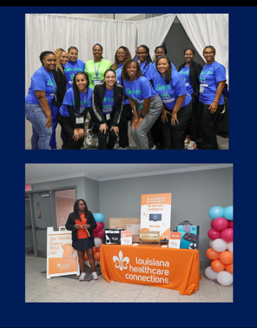
Economic Value of Volunteer Labor
Based on Independent Sector's 2025 valuation of volunteer time at $34.79 per hour for general volunteers and accounting for specialized clinical professional rates:
Clinical professionals (dentists, physicians, optometrists - 30 volunteers @ 8 hours @ $125/hour average): $30,000
Dental hygienists and clinical support (40 volunteers @ 8 hours @ $80/hour average): $25,600
Department directors (14 volunteers @ 72 hours @ $55/hour average): $55,440
General volunteers (101 volunteers @ 8 hours @ $34.79/hour): $28,104
Total volunteer labor value: $139,144
The department directors' extensive pre-clinic work—totaling over 1,000 hours—was essential to the event's success, encompassing volunteer recruitment, supply procurement, logistics coordination, community outreach, scheduling, and operational planning. This behind-the-scenes leadership represents nearly half of all volunteer hours contributed to the event.
West Ascension Parish Hospital

Slide 13
Time Efficiency Analysis
Clinic Event Delivery: The free clinic operated for 12 hours (with directors working 14-hour
days) with 212 volunteers working simultaneously, accomplishing services for 497 patients in a
single day.
Total Project Hours Including Planning:
Clinic day execution: 1,368 hours (198 volunteers × 8 hours average, plus 14 directors × 14 hours)
Pre-clinic planning and development: 1,008 hours (department directors)
Combined total: 2,376 hours
Equivalent Time in Traditional Setting: In a traditional Monday-Friday, 8am-5pm clinic setting (9-hour workdays):
Dental services (295 patients): Assuming 45-minute average appointments = 221 hours of provider time
  In traditional setting: approximately 25 working days (5 weeks)
Vision services (147 exams + fittings): Assuming 30-minute appointments = 74 hours
  In traditional setting: approximately 8 working days (1.6 weeks)
Medical services (64 patients): Assuming 30-minute appointments = 32 hours
  In traditional setting: approximately 4 working days
Total traditional clinic time needed: Approximately 37 working days (7.4 weeks) of sequential service delivery
West Ascension Parish Hospital

Slide 14

Time Efficiency Analysis
Efficiency gained:
By mobilizing 212 volunteers simultaneously, Love Impact Coalition compressed nearly 8 weeks of traditional clinic appointments into a single 12-hour event, demonstrating exceptional operational efficiency and community resource mobilization. While planning required significant upfront investment (1,008 director hours), the model enabled immediate, barrier-free access to comprehensive healthcare services for nearly 500 individuals who would otherwise face weeks of waiting for appointments across multiple providers.
This volunteer-driven model not only provided immediate access to care but eliminated the typical barriers of scheduling, multiple appointments, and extended wait times that patients face in traditional healthcare settings.
West Ascension Parish Hospital

Slide 15
Conclusion
Love Impact Coalition's comprehensive approach to community healthcare—combining large-scale free clinic events with mobile clinic services—addresses multiple dimensions of healthcare access and health equity. The free clinic event served 497 individuals with dental, vision, and medical services, delivering a combined total of $207,642 in direct healthcare value ($105,467 in dental care, $80,525 in vision care, and $21,650 in medical care).
When combined with the economic value of volunteer labor ($139,144), the total community investment in this single-day event exceeded $346,786. This figure does not include the value of facility use, equipment, supplies, or administrative coordination, suggesting the true economic impact likely exceeds $400,000.
The programs revealed critical healthcare needs in the community, particularly related to oral health (evidenced by 150 extractions), vision care, hypertension, and diabetes management. The significant number of uninsured and underinsured patients underscores the essential role of free clinics in filling gaps in the healthcare safety net.
The extraordinary volunteer commitment—with 90% attendance rate and 2,376 total hours contributed, including over 1,000 hours of leadership and planning—demonstrates the depth of community investment in this mission. The operational efficiency achieved—compressing 8 weeks of traditional appointments into 12 hours of service delivery—showcases Love Impact Coalition's exceptional capacity to mobilize community resources effectively.
West Ascension Parish Hospital

Slide 16
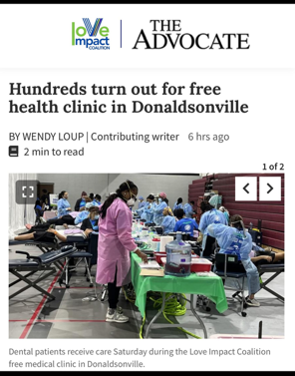
Conclusion
The concentration of patients from the 70346 zip code area and the high prevalence of chronic conditions among patients ages 50-70 provide valuable insights for targeting future outreach and intervention efforts.
Love Impact Coalition continues to serve as a vital healthcare resource, addressing health disparities and improving health outcomes for underserved populations in the region. The organization's model demonstrates that community-driven healthcare delivery can achieve remarkable scale and impact when volunteers, healthcare professionals, and community organizations unite around a common mission. The dedication of department directors, who contributed an average of 72 hours each to make this event possible, exemplifies the transformative power of servant leadership in addressing community health needs.
West Ascension Parish Hospital

Slide 17
West Ascension Parish Hospital
Questions?
Thank you for your time and opportunity to present our Love Impact Coalition 2025 Impact Summary
Ms. Donna Lewis
Dr. Nicole Thomas
Love Impact Coalition
Email: XXXXXX
Phone: (225) XXXXXXXX
Shelton B. Anthony, MBA/MHA
Chief Executive Officer
Email: Shelton.Anthony@westaph.org
Office Phone: (225) 473-7931
Cell Phone: (337) 290-0837

